Slide 1

Credit Card Default
Analysis
2024 | Portfolio Project

Slide 2

Febri Faresi
Credit Risk Analyst
I am a Credit Risk Analyst at private digital bank, responsible for conducting underwriting processes to assess borrower creditworthiness and performing KYC risk assessments. I work to ensure compliance with regulatory standards while managing risks effectively through data analysis and collaboration with relevant teams.
2024 | Portfolio Project
2

Slide 3
Outlines:
Profile Background
Taiwan’s Debt Crisis: Uncovering the Root Causes
Credit Cardholder Transaction Data: A Comprehensive Overview
Gender-Based Demographic Insights: Credit Cardholder Default Risk
Transaction Status Breakdown: Insights into Credit Cardholder Behavior
Default Progression: Analyzing Payment Trends Over Time
Payment Performance Trends: Balancing Outstanding Debt and Repayments
2024 | Portfolio Project
3

Slide 4

Taiwan's Debt Crisis: Uncovering the Root Causes
In past years, credit card issuers in Taiwan faced a debt crisis, with delinquency expected to peak by the third quarter of 2006 (Chou, 2006). To boost market share, banks over-issued credit and cash cards to unqualified applicants. Many cardholders, regardless of their ability to repay, overused their cards and built up large debts. This crisis hurt consumer confidence in finance and posed a major challenge for both banks and cardholders (Cheng, 2009).
In a strong financial system, crisis management comes after risk prediction. The main goal of risk prediction is to use financial data, like business statements and customer transaction records, to foresee business performance or credit risk and minimize potential losses.
2024 | Portfolio Project
4

Slide 5
Credit Cardholder Transaction Data: A Comprehensive Overview
This dataset consists of transaction records from Taiwanese individuals in October 2005, acquired from a major bank (a cash and credit card issuer). The dataset includes 30,000 observations, categorized as either default or non-default, which will be processed for analysis.
Dataset was obtained from the UC Irvine Machine Learning Repository (donated on 1/25/2016) and consists of 25 variables as follows:
Key variable
2. Payment history variables
Variable | Description
ID | Unique number of each clients
Variables | Description
PAY_1 | Repayment status in September
PAY_2 | Repayment status in August
……… | ………………………………
PAY_6 | Repayment status in April
3. Demographic variables
Variable | Description
SEX | Gender of clients
EDUCATION | Highest level of education
MARRIAGE | Marital status
AGE | Age in years
4. Credit limit variable
Variable | Description
LIMIT_BAL | Amount of given credit
2024 | Portfolio Project
5

Slide 6
Credit Cardholder Transaction Data: A Comprehensive Overview (2)
5. Amount of bill variables
6. Amount of prev payment variables
Variables | Description
BILL_AMT1 | Amount of bill statement in September
BILL_AMT2 | Amount of bill statement in August
……… | ………………………………
BILL_AMT6 | Amount of bill statement in April
Variables | Description
PAY_AMT1 | Amount of prev payment in September
PAY_AMT2 | Amount of prev payment in August
……… | ………………………………
PAY_AMT6 | Amount of prev payment in April
7. Dependent variable
Note:
‘SEX’ -> 1 = man, 2 = woman
‘EDUCATION’ -> 1 = grad school, 2 = univ stud, 3 = high school, 4 - 6 = others
‘MARRIAGE’ -> 1 = married, 2 = single, 3 = others
‘PAY_0’ - ‘PAY_6’ -> -2 = prepayment, -1 = pay duly, 0 = grace payment,
1 - 8 = delay 1-8 month
‘BILL_AMT’ -> In period time of month from September - April 2005 (NT$)
‘PAY_AMT’ -> In period time of month from September - April 2005 (NT$)
‘default.payment.next.month’ -> 1 = default, 0 = not default
Variable | Description
def_status | Whether default or not
2024 | Portfolio Project
6

Slide 7
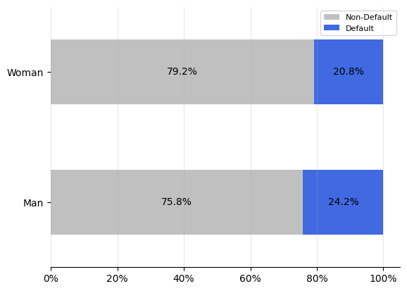
Gender-Based Demographic Insights: Credit Cardholder Default Risk
79.2%
51%
of individuals have attained a University education.
A detailed distribution of default status
49%
of individuals are “married”.
33%
of individuals are between the ages of 31 and 40.
75.8%
49%
of individuals have attained a University education.
A detailed distribution of default status
52%
of individuals are “single”.
37%
of individuals are between the ages of 31 and 40.
Key insight:
The analysis indicates that male clients exhibit a higher default rate compared to female clients, despite a balanced representation between the two. Among defaulters, the majority possess a university-level education. Single clients show a greater likelihood of default compared to married clients, while the 31-40 age group emerges as the most susceptible to default, likely due to heightened financial obligations, positioning them as the highest credit risk demographic.
2024 | Portfolio Project
7

Slide 8
Transaction Status Breakdown: Insights into Credit Cardholder Behavior
 | April | May | June | July | August | September
Prepayment | 4,895 | 4,546 | 4,348 | 4,085 | 3,782 | 2,759
Pay Duly | 6,740 | 5,539 | 5,687 | 5,938 | 6,050 | 5,686
Grace Period | 16,286 | 16,947 | 16,455 | 15,764 | 15,730 | 14,737
1 | 0 | 0 | 2 | 4 | 28 | 3,688
2 | 2,766 | 2,626 | 3,159 | 3,819 | 3,927 | 2,667
3 | 184 | 178 | 180 | 240 | 326 | 322
4 | 49 | 84 | 69 | 76 | 99 | 76
5 | 13 | 17 | 35 | 21 | 25 | 26
6 | 19 | 4 | 5 | 23 | 12 | 11
7 | 46 | 58 | 58 | 27 | 20 | 9
8 | 2 | 1 | 2 | 3 | 1 | 19
44%
the decline in customers making prepayments has been the most significant. Over the past six months, it has dropped by nearly half.
<1%
customers making on-time payments can be considered stable during the sample data period.
9.5%
the decline in customers making payments within the 'grace period' over the past six months remains significant, yet this payment status continues to be the most prevalent.
When viewed holistically, there has been a noticeable rise in late payments ranging from 1 to 8 months over the course of the past semester. This trend suggests a significant decline in the financial strength and payment capacity of credit card customers, indicating a weakening ability to meet their obligations on time.
Note:
1 represents a payment delayed by 1 month, and similarly up to 8, respectively.
Key insights:
The nearly 50% drop in prepayments shows that many customers may be facing financial difficulties. On the other hand, customers who consistently make on-time payments have remained stable, indicating they can handle economic changes. This difference suggests a need to support those at risk of default while maintaining the stability of reliable payers.
From the standpoint of customers who have defaulted, there has been a notable surge in payments that are overdue by one month. Additionally, it is essential to implement a restructuring plan for customers who have experienced a two-month delinquency, with the potential option of deferring their payments to facilitate better financial management and mitigate further risk.
2024 | Portfolio Project
8

Slide 9
Default Progression: Analyzing Payment Trends Over Time
Month | FPD | DPD 1 | DPD 2 | DPD 3 | DPD 4 | DPD 5
April | 11.56% | 11.56% | 1,79% | 3.33% | 2.63% | 2.57%
May | 11.82% | 1.79% | 1.79% | 0.93% | 0.91% | 0.82%
June | 12.04% | 3.33% | 0.93% | 3.33% | 0.96% | 1.36%
July | 11.32% | 2.63% | 0.91% | 0.96% | 2.63% | 0.86%
August | 10.69% | 2.57% | 0.82% | 1.36% | 0.86% | 2.57%
September | 11.65% | 2.56% | 0.86% | 1.15% | 1.19% | 0.82%
Explanation
FPD : first payment default, first payment designated as a default
DPD 1 : day pass due, second payment classified as a default
DPD 2 : day pass due, third payment classified as a default
DPD 3 : day pass due, fourth payment classified as a default
DPD 4 : day pass due, fifth payment classified as a default
DPD 5 : day pass due, sixth payment classified as a default
Key insight:
The consistency of higher default rates in the first billing month across the six-month period indicates a recurring pattern of early payment distress among cardholders. This trend suggests that the majority of defaults tend to occur immediately after the first billing cycle, with little variation from month to month. Additionally, this pattern may highlight that cardholders struggle to meet their payment obligations early on, potentially reflecting underlying financial stress or mismatches between credit issuance and repayment capacity.
2024 | Portfolio Project
9

Slide 10
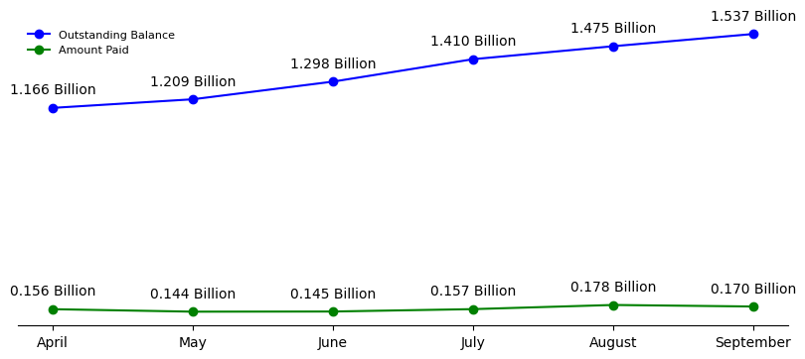
Payment Performance Trends: Balancing Outstanding Debt and Repayments
Key insight:
The graph shows a steady increase in the total outstanding balance from 1.166 billion in April to 1.537 billion in September, while the amount paid remains relatively stable, fluctuating between 0.144 billion and 0.178 billion. This growing gap between the rising outstanding balance and the consistent payment amounts suggests that payments are not keeping pace with the increasing debt, which may indicate a potential financial imbalance if this trend continues.
2024 | Portfolio Project
10
Notes:
Target and actual

Slide 11
Risk-Based Clustering: A Strategic Approach to Credit Cardholders
The segmentation using the KMeans clustering method resulted in three distinct groups based on their respective risk levels. The criteria for each group are as follows:
Cluster 1 - Low Risk
Default rate : 16.48%
Age range : 31-40 y.o
Most marriage status : single
Most education status: grad school
Majority gender: woman
Most pay history : pay duly
Avg bill amounts : NT$7,167
Avg pay amounts : NT$747
Cluster 2 - Medium Risk
Default rate : 18.86%
Age range : 31-40 y.o
Most marriage status : single
Most education status: univ student
Majority gender: woman
Most pay history : grace period
Avg bill amounts : NT$ 183,856
Avg pay amounts : NT$ 6,806
Cluster 3 - High Risk
Default rate : 26.57%
Age range : 21-30 y.o
Most marriage status : single
Most education status: univ student
Majority gender: woman
Most pay history : grace period
Avg bill amounts : NT$ 38,935
Avg pay amounts : NT$ 1,710
Key Insight:
The analysis divides credit cardholders into three risk groups based on their age, education, and payment behavior. Cluster 1 (Low Risk) includes individuals aged 31-40 who are highly educated and manage their finances well, with the lowest default rate of 16.48%. Cluster 2 (Medium Risk) also has individuals aged 31-40, mostly university students, who show a higher default rate (18.86%) and often use the grace period, indicating a need for financial support. Cluster 3 (High Risk) consists of younger individuals aged 21-30, mostly university students, with the highest default rate (26.57%) and low bill amounts, suggesting the need for stricter credit limits and financial education to reduce risk.
2024 | Portfolio Project
11

Slide 12

To access the full document, you can refer to the following websites:

